Slide 1
Role of Denosumab in CKD associated Osteoporosis

Slide 2
Outline
Definitions and Diagnosis of CKD-Associated Osteoporosis
Epidemiology
Managing CKD-MBD
Pathophysiology
Diagnosis
Management/Treatment
Clinical Overview
Safety of Denosumab
Summary and recommendations

Slide 3
Introduction
CKD-MBD is a common complication of CKD that arises early in the course of the disease, and it is associated with high morbidity and mortality.
The term CKD-MBD is used broadly to describe abnormalities in mineral metabolism, skeletal health, and soft-tissue calcifications.
The skeletal derangements associated with CKD-MBD are associated with bone loss and fractures.
Compared with the general population, fracture incidence rates are more than fourfold higher, and they are associated with greater morbidity and mortality
Clin J Am Soc Nephrol 13: 962–969, 2018.

Slide 4
Definitions and Diagnosis of CKD-Associated Osteoporosis
The World Health Organization defines osteoporosis as a T score ≤ 22.5
Osteoporosis can also be defined clinically as the presence of a low trauma fracture with or without BMD in the osteoporotic range.
A mechanistic definition of osteoporosis a skeletal disorder characterized by compromised bone strength predisposing a person to an increased risk of fracture.
Clin J Am Soc Nephrol 13: 962–969, 2018.

Slide 5
Epidemiology and Costs of CKD-Associated Osteoporosis and Fractures in CKD
Data from the National Health and Nutrition Examination Survey (NHANES) suggest that CKD and osteoporosis are highly coprevalent
Among NHANES III participants, osteoporosis was twice as common in those with an eGFR, > 60 ml/min compared with thosewith an eGFR<60 ml/min.
Among women and men with osteoporosis, 80% and 50%, respectively, had a Cockcroft–Gault creatinine clearance , < 35 ml/min.
In patients with predialysis CKD, a history of osteoporosis was reported to be associated with a greater than twofold odds of hip fracture compared with the general population
Clin J Am Soc Nephrol 13: 962–969, 2018.

Slide 6
The Changing Paradigm of Managing CKD-Associated Osteoporosis
The paradigm to managing CKD-associated osteoporosis is evolving.
The 2005 KDIGO committee shifted the historical nomenclature of renal osteodystrophy type to a unified classification system on the basis of bone turnover, mineralization, and volume, and turnover is now classified as low, normal, or high turnover renal osteodystrophy.
The current treatment paradigm for renal osteodystrophy has focused on suppressing
high turnover with active vitamin D and/or calcimimetics, while simultaneously avoiding the development of adynamic bone disease through excessive use of these same agents.
Clin J Am Soc Nephrol 13: 962–969, 2018.

Slide 7
The Changing Paradigm of Managing CKD-Associated Osteoporosis
There are no data to suggest that this approach has been successful in decreasing all-type fracture rates; in contrast, epidemiologic data suggest the opposite.
It is expected that the treatment paradigm for CKD-associated osteoporosis will evolve due to the update and that it will reflect the use of DXA to screen patients for risk of fracture and target them for anti-fracture strategies.
Clin J Am Soc Nephrol 13: 962–969, 2018.

Slide 8
Overview of available therapies for kidney-associated osteoporosis
Drugs | Dosage | FDA-Approved eGFR Cutoffs | Effect on Mineral Metabolism
Alendronate | 70 mg PO once weekly | eGFR≥35 ml/min | Hypocalcemia, hypophosphatemia
Ibandronate | 150 mg PO once monthly or 3 mg iv every 3 mo | eGFR.>30 ml/min | -
Risendronate | 5 mg PO daily or 35 mg PO weekly | eGFR. >30 ml/mi | Hypocalcemia, hypophosphatemia, increased PTH levels
Abaloparatide | 80 µg Subcutaneously once daily | Any eGFR, not studied in ESKD | Hypercalcemia, hypercalciuria
Teriparatide | 20–40 µg Subcutaneous daily | eGFR. >30 ml/min | Hypercalcemia, hypocalcemia, hypercalciuria
Denosumab | 60 mg Subcutaneous every 6 mo | Any eGFR | Hypocalcemia, hypophosphatemia
Romosozumab | 210 mg Subcutaneous monthly | Not studied in CKD | -
FDA, Food and Drug Administration; PO, per oral; iv, intravenous; —, unknown PTH, parathyroid hormone.
Clin J Am Soc Nephrol 13: 962–969, 2018.

Slide 9
Managing CKD-MBD
Before initiating an antiresorptive or anabolic agent to treat CKD-associated osteoporosis
It is important to manage CKD-MBD through control of vitamin D deficiency, hyperphosphatemia, and hyperparathyroidism.
Secondary hyperparathyroidism is a major feature of CKD-MBD.
It begins early in the course of CKD, and its prevalence increases as kidney function declines.
Clin J Am Soc Nephrol 13: 962–969, 2018.

Slide 10
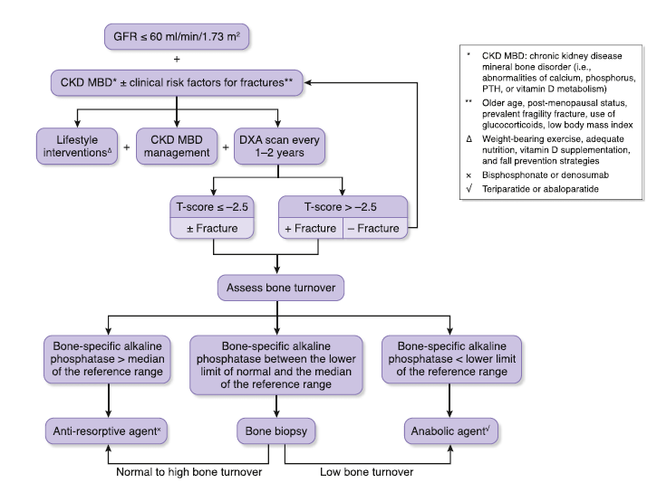
An algorithm for fracture risk screening and initiation of anti-fracture strategies in patients with CKD
Clin J Am Soc Nephrol 13: 962–969, 2018.

Slide 11
Pathophysiology
Corticosteroid-Induced Osteoporosis
Transplantation Osteoporosis

Slide 12
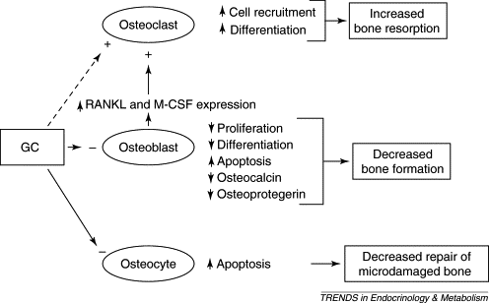
GC induced osteoporosis

Slide 13
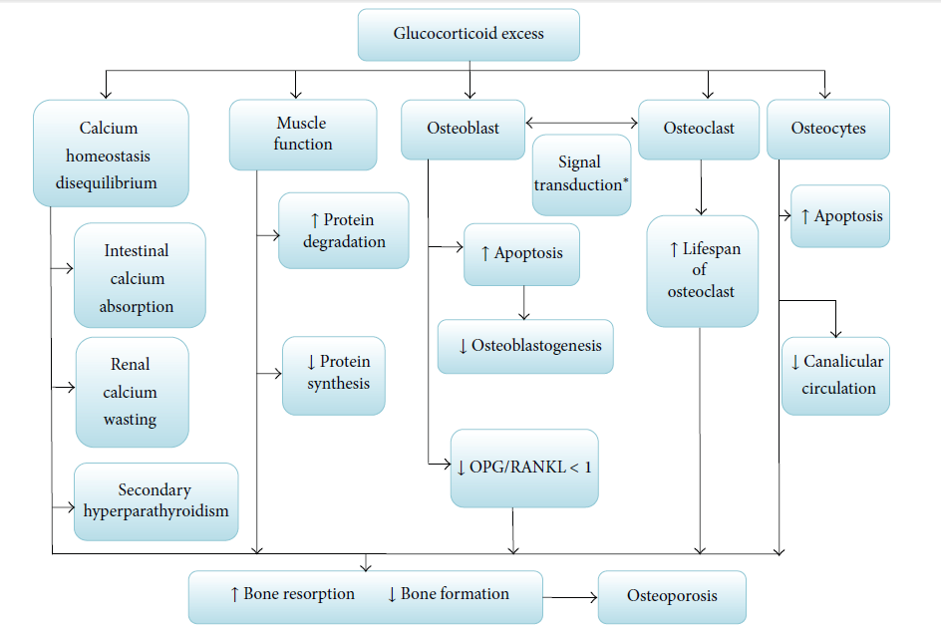
Transplantation Osteoporosis

Slide 14
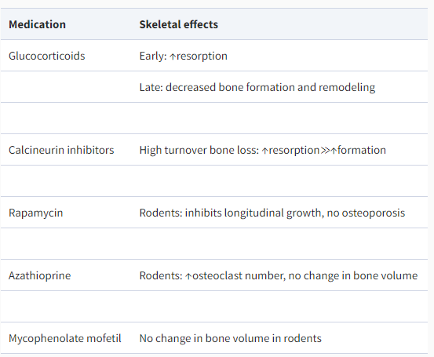
Transplantation Osteoporosis

Slide 15
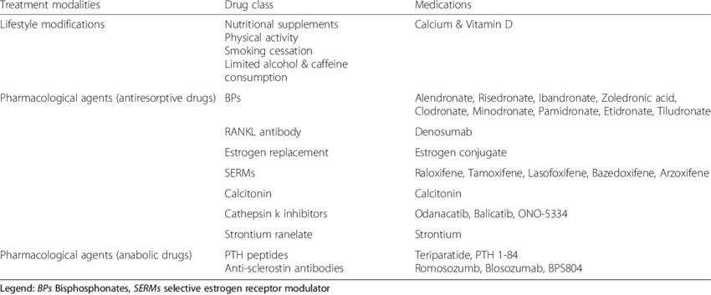
Treatment of osteoporosis

Slide 16
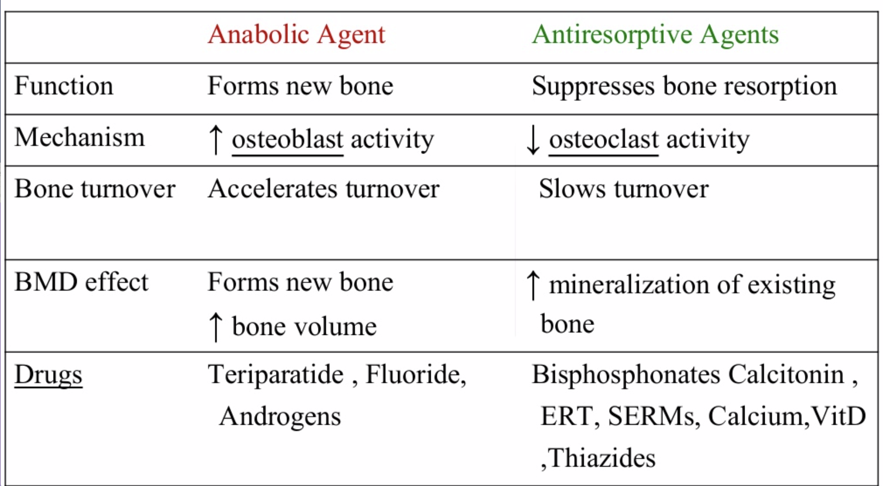

Slide 17
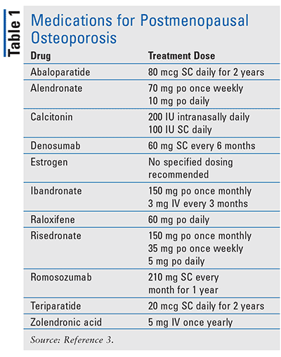
BP : Zoledronic acid
Denosumab
Teriparatide
Romosozumab

Slide 18
Laboratory Studies
Baseline Laboratory Studies for Underlying Disorders in Osteoporosis
CBC
Serum chemistry levels
Liver function tests
TSH level
25- Hydroxyvitamin D level
Tests for Secondary Causes of Osteoporosis
24-Hour urine calcium level
PTH level
Thyrotropin level (if on thyroid replacement)
Testosterone and gonadotropin levels in younger men with low bone densities
Bone marrow biopsy
Notes:
Complete blood count (CBC) –
CBC results may reveal anemia, as in sickle cell disease (patients with anemia, particularly those older than 60 years, should also be evaluated for multiple
Serum chemistry levels-
Calcium levels can reflect underlying disease states (eg, severe hypercalcemia may reflect underlying malignancy or hyperparathyroidism; hypocalcemia can contribute to osteoporosis)
Levels of serum calcium, phosphate, and alkaline phosphatase are usually normal in persons with primary osteoporosis, although alkaline phosphatase levels may be elevated for several months after a fracture
Levels of serum calcium, phosphate, and alkaline phosphatase may be obtained to assess osteomalacia
Creatinine levels may decrease with increasing parathyroid hormone (PTH) levels or may be elevated in patients with multiple myeloma
Creatinine levels are also used to estimate creatinine clearance, which may indicate reduced renal function in elderly patients
Magnesium is very important in calcium homeostasis[118] ; decreased levels of magnesium may affect calcium absorption and metabolism
Liver function tests
Increased levels of alanine aminotransferase (ALT), aspartate aminotransferase (AST), gamma-glutamyl transferase (GGT), bilirubin, and alkaline phosphatase may indicate alcohol abuse
An elevated level of alkaline phosphatase in combination with normal calcium, phosphate, and aminotransferase should prompt consideration of Paget disease
Thyroid-stimulating hormone (TSH) level
Thyroid dysfunction has been associated with osteoporosis and should therefore be ruled out
25- Hydroxyvitamin D level
This test assesses for vitamin D insufficiency; inadequate vitamin D levels can predispose persons to osteoporosis through a mechanism of secondary hyperparathyroidism
If vitamin D insufficiency and bone pain are present, consider the alternative diagnosis of osteomalacia
Tests for Secondary Causes of Osteoporosis
24-Hour urine calcium level
This study assesses for hypercalciuria and hypocalciuria
Parathyroid hormone (PTH) level
An intact PTH result is essential in ruling out hyperparathyroidism; an elevated PTH level may be present in benign familial hypocalciuric hypercalcemia
Thyrotropin level (if on thyroid replacement)
Experts are divided on whether to include thyrotropin testing, regardless of a history of thyroid disease or replacement; however, one study showed reduced femoral neck bone mineral density (BMD) in women with subclinical hypothyroidism and hyperthyroidism[
Testosterone and gonadotropin levels in younger men with low bone densities
These tests may help evaluate a sex hormone deficiency as a secondary cause of osteoporosis
Bone marrow biopsy
This study is obtained when a hematologic disorder is suspected

Slide 19
Monitoring therapy
Monitoring the response to therapy is important for identifying patients who may require a change in therapy.
eGFR ≥30 mL/min/1.73 m²
In patients with Egfr ≥30 mL/min/1.73 m, monitoring is similar to patients without CKD.
eGFR <30 mL/min/1.73 m²
In patients with eGFR <30 mL/min/1.73 m2, we measurethe following blood tests every four months and also approximately 10 days after denosumab administration:
Calcium
Phosphorus
25-hydroxyvitamin D
Parathyroid hormone (PTH)

Slide 20
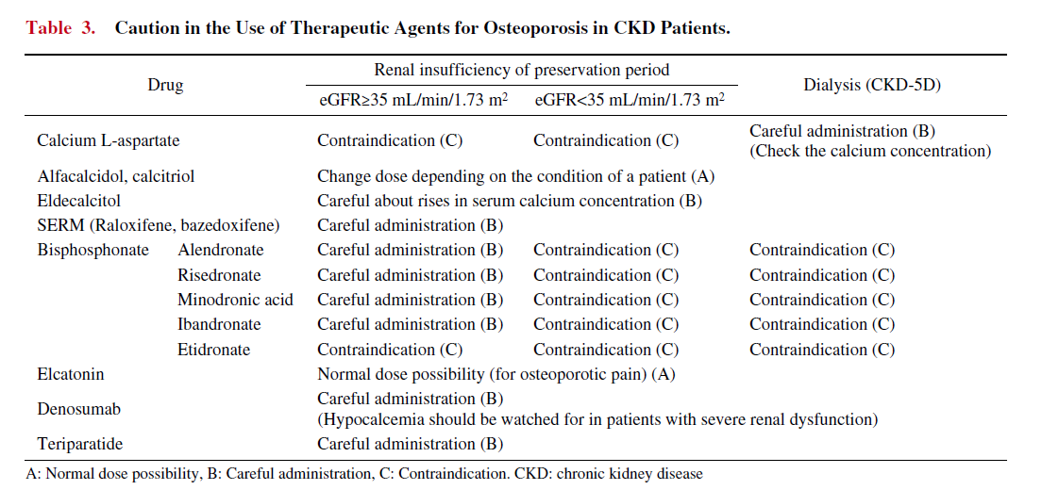
Caution in the Use of Therapeutic Agents for Osteoporosis in CKD Patients.
Notes:
Intern Med 56: 3271-3276, 2017

Slide 21
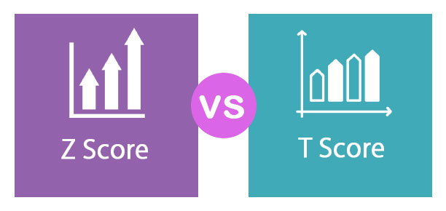
Diagnosis
DXA also offers the patient's Z-score, which is a value that is compared to that of people of similar age and gender.
In the following patients, Z-scores adjusted for ethnicity or race should be used:
Premenopausal women
Men younger than 50 years
Children
Notes:
A Z-score compares your bone density to the average values for a person of your same age and gender.

Slide 22
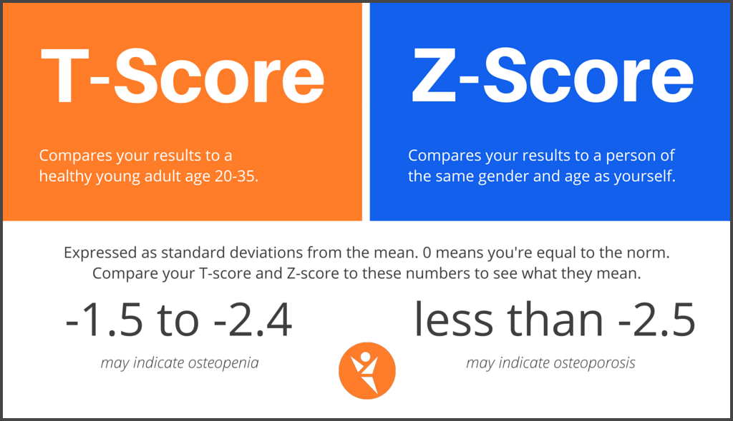

Slide 23
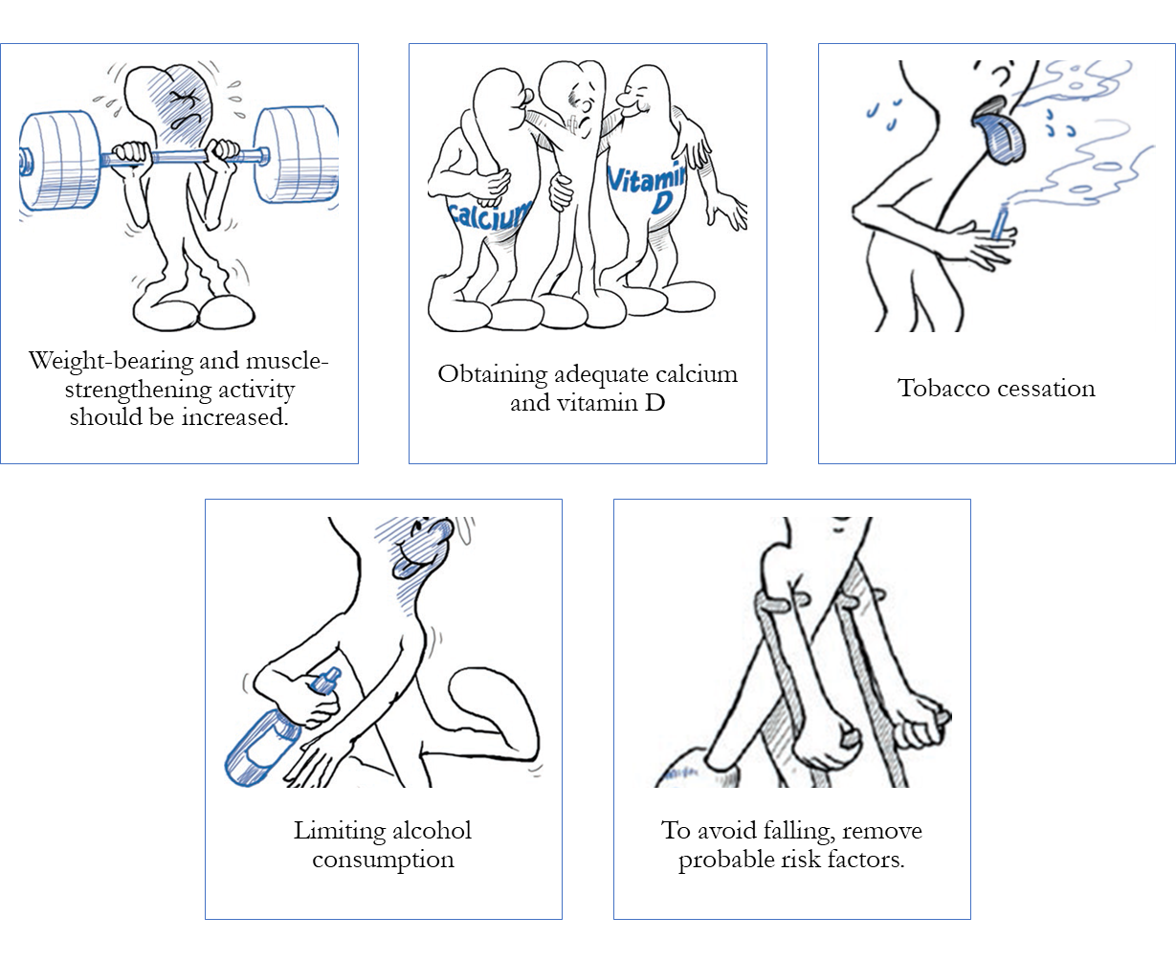
Management
Nonpharmacological
Lifestyle modification for the prevention of osteoporotic fractures includes the following:

Slide 24
Treatment
The main goal of treatment is to prevent fractures.
All optimal therapeutic agents have the following characteristics:
The drug must be well tolerated and safe, with few side effects.
Bioavailability should be evaluated both orally and intravenously.

Slide 25
Classes of Osteoporosis Medications
To treat osteoporosis, there are two basic pharmacological approaches:
Anabolic therapy
Anticatabolic or antiresorptive therapy
Which stimulates new bone formation
Which decreases bone resorption and ⁄ or inhibits bone turnover

Slide 26
Summary of treatment modalities for osteoporosis
Treatment modalities | Drug class | Medications
Lifestyle modifications | Nutritional supplements Physical activity Smoking cessation Limited alcohol & caffeine consumption | Calcium & Vitamin D
Pharmacological agents (antiresorptive drugs) | BPs | Alendronate, Risedronate, Ibandronate, Zoledronic acid, Clodronate, Minodronate, Pamidronate, Etidronate, Tiludronate
 | RANKL antibody | Denosumab
 | Estrogen replacement | Estrogen conjugate
 | SERMs | Raloxifene, Tamoxifene, Lasofoxifene, Bazedoxifene, Arzoxifene
 | Calcitonin | Calcitonin
 | Cathepsin k inhibitors | Odanacatib, Balicatib, ONO-5334
 | Strontium ranelate | Strontium
Pharmacological agents (anabolic drugs) | PTH peptides Anti-sclerostin antibodies | Teriparatide, PTH 1-84 Romosozumb, Blosozumab, BPS804

Slide 27
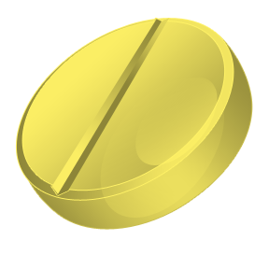


Drugs used and approved to treat osteoporosis
 | Oral daily | Oral weekly | Oral monthly | S.C daily | S.C every 6 Month | Injection Quarterly | Infusion Annually
Alendronate | 10 mg | 70 mg
Risedronate | 5 mg | 35 mg | 150 mg
Ibandronate |  |  | 150 mg |  |  | 3 mg
Zoledronate |  |  |  |  |  |  | 5 mg
Strontium ranelate | 2 g
Teriparatide |  |  |  | 20 μg
Abaloparatide |  |  |  | 80 μg
Denosumab |  |  |  |  | 60 mg
Notes:
R. Bartl, C. Bartl, The Osteoporosis Manual, https://doi.org/10.1007/978-3-030-00731-7_23

Slide 28
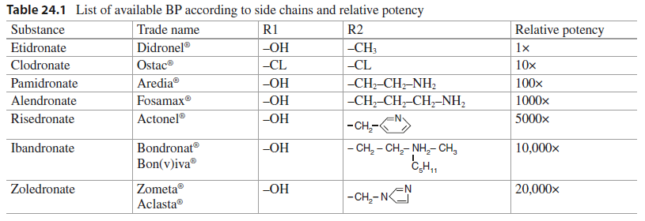
Bisphosphonates (BPs)
Notes:
R. Bartl, C. Bartl, The Osteoporosis Manual, https://doi.org/10.1007/978-3-030-00731-7_23

Slide 29
Key differences between and bisphosphonates and denosumab
Feature | Bisphosphonates | Denosumab
Molecular target Structure Effect on osteoclast The onset of action Nephrotoxicity | Cellular metabolic enzymes; for the nitrogen-containing bisphosphonates, the key target is Farnesyl pyrophosphate (FPPS) an enzyme needed for modification (prenylation) of protein Small-molecule drugs Induce apoptosis; 6 to 12 months * Released bisphosphonates are cleared by the kidney Intravenous bisphosphonates have a higher risk of side effects than oral bisphosphonates, including nephrotoxicity of various sorts. | Binds with high affinity and specificity to circulating RANKL Monoclonal antibody Inhibits osteoclast formation, function, and survival rapid onset of action Within 3 days# Cleared by the reticuloendothelial system with a half-life of approx. 26 days Denosumab does not cause nephrotoxicity.
Int J Clin Pract, December 2012, 66, 12, 1139–1146

Slide 30
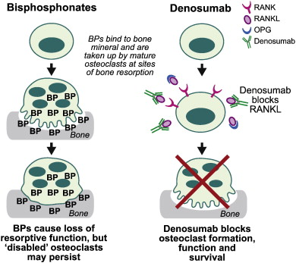
MOA for Denosumab and bisphosphonates
Denosumab is a more potent bone resorption inhibitor than BP.
When denosumab medication is stopped, the suppression of bone turnover is quick and completely reversed.

Slide 31
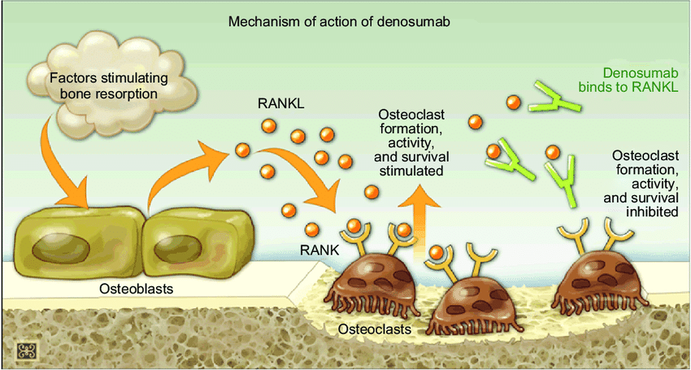
Denosumab is a monoclonal antibody that is fully human and was approved by the FDA as the first RANKL inhibitor.
RANK is activated by the ligand RANKL, which is present on the cell surface of osteoblasts.
By activating RANK, RANKL promotes the development of pre-osteoclasts into active osteoclasts.
Denosumab binds to RANKL and inhibits it, inhibiting the formation of osteoclasts.
This reaction protects the bone from resorption by mimicking the natural activity of OPG.

Slide 32
Denosumab
Class:
Bone Resorption Inhibitors
Chemical Name:
Anti-(human osteoclast differentiation factor) (human monoclonal AMG162 heavy chain), disulfide with human monoclonal AMG162 light chain immunoglobulin G2 dimer.

Slide 33
Denosumab
Denosumab is a potent antiresorptive agent.
It is an mAb against the receptor activator of NF-kB ligand, and it inhibits osteoclast proliferation and development.
In contrast to bisphosphonates, denosumab is not cleared by the kidney; therefore, there is no risk of over suppressing bone turnover due to drug accumulation in CKD.
Clin J Am Soc Nephrol 13: 962–969, 2018.

Slide 34

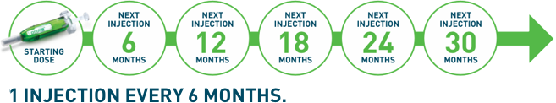
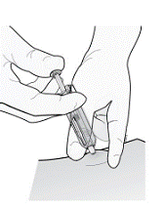
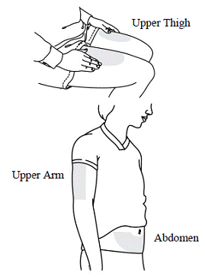
Denosumab Dose and Administration
TREATMENT OF PATIENTS WITH OSTEOPOROSIS AT HIGH RISK FOR FRACTURE
Approved Indication:
Treatment Of Postmenopausal Women With Osteoporosis At High Risk For Fracture.
Treatment To Increase Bone Mass In Men With Osteoporosis
Treatment Of Glucocorticoid-Induced Osteoporosis
Treatment Of Bone Loss In Men Receiving Androgen Deprivation Therapy For Prostate Cancer
Treatment Of Bone Loss In Women Receiving Adjuvant Aromatase Inhibitor Therapy For Breast Cancer
Dosage and Administration:
Information Essential To Safe Dosing Or Administration
Pregnancy must be ruled out prior to administration of Denosumab.
Perform pregnancy testing in all females of reproductive potential prior to administration of Denosumab.
The recommended dose of Denosumab.
60 mg administered as a single S.C injection once every 6 months.
Administer Denosumab via S.C injection in the upper arm, the upper thigh, or the abdomen.
All patients should receive calcium 1000 mg daily and at least 400 IU vitamin D daily
Choose an injection site.
The recommended injection sites for Denosumab include the upper arm OR the upper thigh OR the abdomen.
Contraindications:
Hypocalcemia

Slide 35
Denosumab Dose and Administration
TREATMENT OF PATIENTS WITH OSTEOPOROSIS AT HIGH RISK FOR FRACTURE
Warnings and precaution
Hypocalcemia: Must be corrected before initiating Denosumab It May worsen especially in patients with renal impairment. Adequately supplement patients with calcium and vitamin D
Serious infections including skin infections: Advise patients to seek prompt medical attention if they develop signs or symptoms of infection, including cellulitis
Dermatologic reactions: Dermatitis, rashes, and eczema have been reported. Consider discontinuing Denosumab if severe symptoms develop
Osteonecrosis of the jaw: Has been reported with Denosumab Monitor for symptoms
Suppression of bone turnover: Significant suppression has been demonstrated. Monitor for consequences of bone over suppression
Adverse reactions
The Most common adverse reactions (> 5% and more common): back pain, pain in extremity, hypercholesterolemia, musculoskeletal pain, and cystitis. Pancreatitis may occur
Use in specific populations
Pregnancy: Based on animal data, may cause fetal harm.
Nursing mothers: May impair mammary gland development and lactation. Discontinue drug or nursing
Pediatric patients: Safety and efficacy not established
Renal impairment: No dose adjustment is necessary in patients with renal impairment. Patients with creatinine clearance < 30 mL/min or receiving dialysis are at risk for hypocalcemia. Supplement with calcium and vitamin D and consider monitoring serum calcium
Overdosage.
There is no experience with overdosage with Denosumab .

Slide 36
Antiresorptive Therapy
Algorithm

Slide 37
CKD
CKD stage 1–3 disease
CKD G1–G2 with osteoporosis and/or high risk of fracture*
CKD G3a–G3b with PTH in the normal range and osteoporosis and/or high risk of fracture*
As defined by the World Health Organization (WHO), osteoporosis is present when BMD is 2.5 SD or more below the average value (a T-score of <−2.5 SD).
Baseline serum calcium, phosphate, PTH, alkaline phosphatase (ALP), and 25 hydroxyvitamin D (25-OHD)
Normal
Antiresorptive medications as per usual osteoporosis guidelines

Slide 38
CKD
CKD stage 4-5 disease
High Country-specific FRAX fracture possibility
Postmenopausal , Age > 50 years
DXA-based BMD at spine or hip: T ≤ –2.5
Lateral imaging of spine Vertebral fracture assessment
Fragility fractures (spine, hip, proximal humerus, pelvis or multiple)
Bone biopsy - Suggested particularly in those with CKD stage 3a–5D 2017 update to the KDIGO guidelines emphasize that antiresorptive therapy should not be withheld for bone biopsy

Slide 39
CKD
CKD stage 4-5 disease
KDIGO suggests, that if baseline serum calcium, phosphate, PTH, and 25-OHD are abnormal, the following might be considered
CKD–MBD and metabolic control
HYPERPHOSPHATEMIA
Reduce dietary phosphate
If resistant, phosphate binders can be considered
In CKD stage 5, dialytic removal of phosphate can be used
HYPOCALCEMIA
Serum calcium should be maintained within the reference range,
VITAMIN D
HYPERPARATHYROIDISM
If PTH remains out of target despite correction of hypocaalcemia, hyperphosphatemia, and use of vitamin D analogs, calcimimetics followed by parathyroidectomy might be considered
RULE OUT ADYNAMIC BONE DISEASE
Hemodialysis (HD) patients (in whom adynamic bone disease is particularly prevalent), bs- ALP < 20 μg/L (0.02 U/L) and PTH < 200 ng/L (21 pmol/L) had 100% sensitivity, 100% specificity, 100% PPV, and 84% NPV for adynamic bone disease
The use of antiresorptive medications in adynamic bone disease might worsen bone health
Antiresorptive medications as per usual osteoporosis guidelines

Slide 40
GUIDELINES of Antiresorptive medications as per usual osteoporosis
Denosumab
Clinical use
Denosumab in osteoporosis/ osteopenia associated with Kidney Transplant Patients Denosumab in osteoporosis/ osteopenia associated with CKD
Dosage
60 mg once in 6 months subcutaneous + Calcium 1000 mg + at least 400 IU vitamin D daily through the duration of therapy
Common
Adverse effect
Back pain, extremity pain, musculoskeletal pain, hypercholesterolemia, cystitis (postmenopausal women) or back pain, arthralgia, nasopharyngitis (men)
Correct preexisting hypocalcemia prior to initiating denosumab.
severe renal impairment (Clcr <30 mL/minute) or receiving dialysis are at greater risk of developing hypocalcemia
Pregnancy and lactation : not recommended
Pediatric : not recommended < 4 years
Renal impairment : no dose adjustment
Hepatic Impairment: no dose adjustment
Precautions
Monitoring
Clinical monitoring of calcium and mineral levels (phosphorus and magnesium) is highly recommended within 14 days of injection.
Hypocalcemia persisted for weeks or months and required frequent monitoring and intravenous and/or oral calcium replacement, with or without vitamin D
Onset
Studies in postmenopausal women with osteoporosis indicate reduction in bone resorption biomarkers observed within 3 days after a 60-mg dose; maximal reductions observed by 1 month
Reversal of effect
Bone mineral density (BMD) and levels of bone resorption markers return to baseline within 12 months after discontinuing denosumab.
Contraindication
Hypocalcemia, Pregnancy, Hypersensitivity
Duration of therapy
FREEDOM 7 years Extension trial reported safety and efficacy of Denosumab

Slide 41
CKD
CKD stage 1–3 disease
CKD stage 4-5 disease
Kidney transplant bone disease
CKD G1–G2 with osteoporosis and/or high risk of fracture*
CKD G3a–G3b with PTH in the normal range and osteoporosis and/or high risk of fracture*
First 12 months
After12 months
As defined by the WHO, osteoporosis is present when BMD is 2.5 SD or more below the average value (a T-score of <−2.5 SD).
eGFR > 30 ml/min/ 1.73 m2 and low BMD, treatment with vitamin D, calcitriol/alfacalcidol, and/or antiresorptive agents be considered
Insufficient data to guide on treatment after 12 months
Baseline serum calcium, phosphate, PTH, alkaline phosphatase (ALP), and 25 hydroxyvitamin D (25-OHD)
Normal
Antiresorptive medications as per usual osteoporosis guidelines
*Risk factors by 2020 AACE
Prior fracture without major trauma (other than fingers, toes, skull) after age 50 years | Clinical risk factors for osteoporosis Age ≥65 years Low body weight Smoking Early menopause Excessive alcohol intake | Prior spine fractures Glucocorticoid therapy equivalent to ≥5 mg of prednisone per day for 3months or more Secondary osteoporosis Height loss of kyphosis Risk factors for falling With radiographic osteopenia
Lifestyle modification • Nutrition • Vitamin D • Weight-bearing physical activity • Fall prevention • Cessation of smoking
Follow-up • Assess for compliance and side effects • BTMs to verify compliance • Beware of discontinuing denosumab

Slide 42
CKD
CKD stage 4-5 disease
High
Country-specific FRAX fracture possibility
DXA-based BMD at spine or hip: T ≤ –2.5
Fragility fractures (spine, hip, proximal humerus, pelvis or multiple)
Postmenopausal , Age > 50 years
Lateral imaging of spine
Vertebral fracture assessment
Bone biopsy
Suggested particularly in those with CKD stage 3a–5D
2017 update to the KDIGO guidelines emphasize that antiresorptive therapy should not be withheld for bone biopsy
KDIGO suggests, that if baseline serum calcium, phosphate, PTH, and 25-OHD are abnormal, the following might be considered
CKD–MBD and metabolic control
Hyperphosphatemia
Reduce dietary phosphate
If resistant, phosphate binders can be considered
In CKD stage 5, dialytic removal of phosphate can be used
Hyperparathyroidism
If PTH remains out of target despite correction of hypocalcemia, hyperphosphatemia, and use of vitamin D analogs, calcimimetics followed by parathyroidectomy might be considered
Vitamin D
Hypocalcemia
Serum calcium should be maintained within the reference range,
Rule out adynamic bone disease
Hemodialysis (HD) patients (in whom adynamic bone disease is particularly prevalent), bs- ALP < 20 μg/L (0.02 U/L) and PTH < 200 ng/L (21 pmol/L) had 100% sensitivity, 100% specificity, 100% PPV, and 84% NPV for adynamic bone disease
The use of antiresorptive medications in adynamic bone disease might worsen bone health
Antiresorptive medications as per usual osteoporosis guidelines
Notes:
750651

Slide 43
Antiresorptive medications as per usual osteoporosis guidelines
Lifestyle modification • Nutrition • Vitamin D • Weight-bearing physical activity • Fall prevention • Cessation of smoking
Follow-up • Assess for compliance and side effects • BTMs to verify compliance • Beware of discontinuing denosumab
Denosumab
Clinical use Denosumab in osteoporosis/ osteopenia associated with Kidney Transplant Patients
Denosumab in osteoporosis/ osteopenia associated with CKD
Dosage
60 mg once in 6 months subcutaneous + Calcium 1000 mg + at least 400 IU vitamin D daily through the duration of therapy
Onset
Studies in postmenopausal women with osteoporosis indicate reduction in bone resorption biomarkers observed within 3 days after a 60-mg dose; maximal reductions observed by 1 month
Common adverse effect
Back pain, extremity pain, musculoskeletal pain, hypercholesterolemia, cystitis (postmenopausal women) or back pain, arthralgia, nasopharyngitis (men)
Reversal of effect
Bone mineral density (BMD) and levels of bone resorption markers return to baseline within 12 months after discontinuing denosumab.
Precaution
Correct preexisting hypocalcemia prior to initiating denosumab.
severe renal impairment (Clcr <30 mL/minute) or receiving dialysis are at greater risk of developing hypocalcemia
Pregnancy and lactation : not recommended
Pediatric : not recommended < 4 years
Renal impairment : no dose adjustment
Hepatic Impairment: no dose adjustment
Contraindication
Hypocalcemia, Pregnancy, Hypersensitivity
Duration of therapy
FREEDOM 7 years Extension trial reported safety and efficacy of Denosumab
Monitoring
Clinical monitoring of calcium and mineral levels (phosphorus and magnesium) is highly recommended within 14 days of injection.
Hypocalcemia persisted for weeks or months and required frequent monitoring and intravenous and/or oral calcium replacement, with or without vitamin D

Slide 44

Clinical Overview

Slide 45
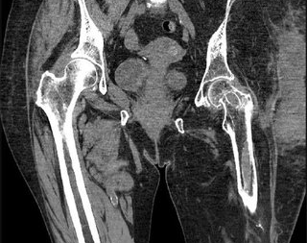
Glucocorticoid-induced Osteoporosis

Slide 46






Title: The therapeutic efficacy of denosumab for the loss of bone mineral density in glucocorticoid-induced osteoporosis: a meta-analysis
Aim: To evaluate the impact of denosumab on BMD loss in patients with GIO.
Key massage: Denosumab resulted in significant increases in BMD in the lumbar spine and femoral neck at 12months compared with bisphosphonate therapy
At 6 and 12months of denosumab therapy
Seven studies
Denosumab at 60 mg subcutaneously every 6 months
Increases in BMD were observed in the lumbar spine (2.99% [95% CI 2.71, 3.28] and 4.59% [95% CI 4.17, 5.01]), total hip (1.34% [95% CI 0.64, 2.04] and 2.16% [95% CI 2.05, 2.27]) and femoral neck (0.12% [95% CI 0.38, 0.62] and 1.55% [95% CI 0.45, 2.65]).
NA
Patients with GIO experienced significant increases in BMD in response to treatment with denosumab that were detected in the lumbar spine, total hip and femoral neck at 12 months
Abbreviations: GIO: Glucocorticoid-induced Osteoporosis; BMD:Bone Mass density CI: confidence interval
Ref: Rheumatology Advances in Practice 2020;0:1–10.

Slide 47
Study Title | Denosumab in the treatment of glucocorticoid induced osteoporosis
Reference | Drug Design, Development and Therapy 2019:13 2843–2852
Study design / type | A systematic review and meta-analysis
Objectives | To summarize the efficacy and safety of denosumab in the prevention and treatment of GIOP.
Study population | Three eligible studies were included in the primary meta-analysis (N=361)
Groups/Sample size | We searched PubMed, CINAHL, ACR and American Society for Bone and Mineral Research meeting abstracts for relevant studies. included studies in which subjects were taking systemic glucocorticoid therapy and were assigned to take denosumab or control therapy, and Assessed the effect of treatment on areal BMD, fractures and/or safety.
Key findings | Denosumab significantly increased lumbar spine BMD (2.32%, 95% CI 1.73%, 2.91%, P<0.0001) and hip BMD (1.52%, 95% CI 1.1%,1.94%, P<0.0001) compared to bisphosphonates. Adverse events, serious adverse events and fractures were similar between denosumab and bisphosphonate arms.
Conclusion | Results suggest that denosumab is superior to bisphosphonates in its effects on lumbar spine and total hip BMD in patients with GIOP.

Slide 48
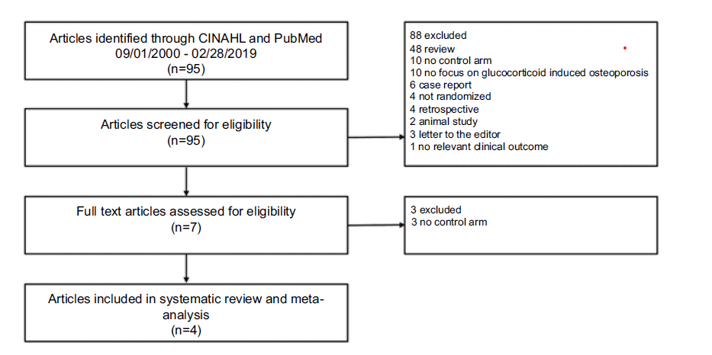
Denosumab in the treatment of glucocorticoid-induced osteoporosis

Slide 49
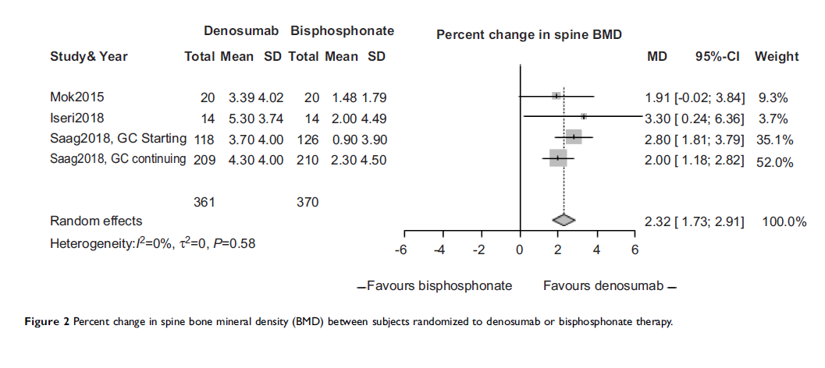
Denosumab in the treatment of glucocorticoid induced osteoporosis

Slide 50
Study Title | Denosumab Versus Risedronate in Glucocorticoid-Induced Osteoporosis
Reference | Arthritis & Rheumatology Vol. 71, No. 7, July 2019, pp 1174–1184
Study design / type | Randomized, Double-Blind, Double-Dummy Trial
Objectives | The present analysis was performed to compare efficacy and characterize safety through month 24.
Study population | N=590
Groups /Sample size | Patients were randomized 1:1 within each subpopulation to receive s.c denosumab 60 mg Q6M and Oral placebo (for risedronate) QD for 24 months, or oral risedronate 5 mg QD and s.c placebo (for denosumab) Q6M
Duration of study | 24 months
Key findings | Denosumab was superior to risedronate in increasing lumbar spine and total hip BMD at all time points assessed, among glucocorticoid-initiating patients 24-month lumbar spine: BMD increase of 6.2% versus 1.7%, respectively 24-month total hip: BMD increase of 3.1% versus 0.0% and among glucocorticoid-continuing patients 24-monthly bar spine: BMD increase of 6.4% versus 3.2% 24-month total hip: BMD increase of 2.9% versus 0.5%). Adverse events, SAEs (including infections), and fractures were similar between treatment groups.
Conclusion | Denosumab was superior to risedronate in terms of increases in spine and hip BMD through month 24, and the safety profile was similar between treatment groups.

Slide 51
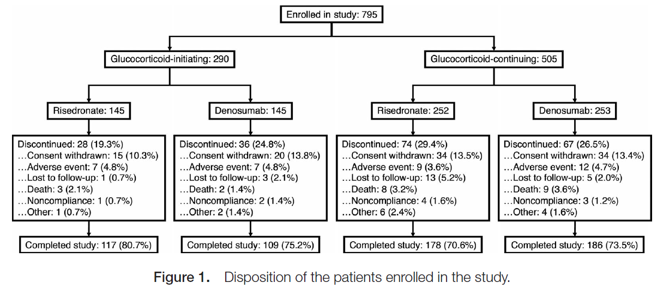
Denosumab Versus Risedronate in Glucocorticoid-Induced Osteoporosis

Slide 52
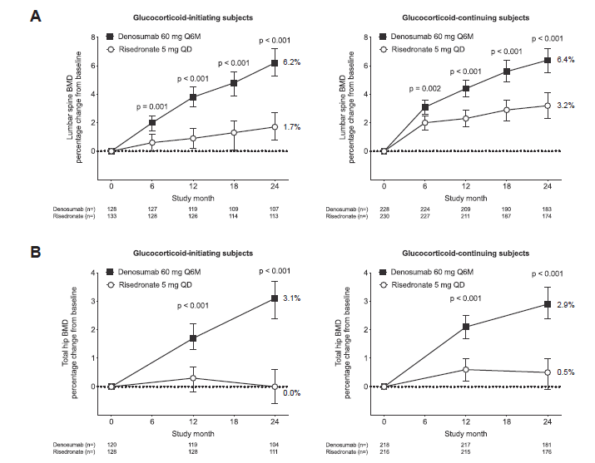
Results
Figure. Percentage change from baseline in BMD at the lumbar spine (A), total hip (B), femoral neck (C), and 1/3 radius (D) for each subpopulation.
Between-group comparisons are based on analysis of covariance models with adjustment for treatment, baseline BMD, sex, machine type, and baseline BMD × machine type interaction.
For the glucocorticoid-continuing subpopulation, duration of prior glucocorticoid use (<12 months versus ≥12 months) was included as an additional covariate.
Values are the least squares means and 95% confidence intervals. Q6M = once every 6 months; QD = once daily.

Slide 53
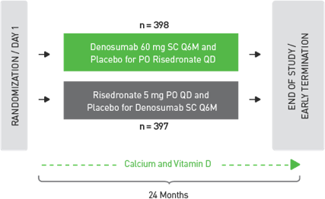
Denosumab has been evaluated in a head-to-head BMD study of patients with glucocorticoid-induced osteoporosis
12-Month Primary Analysis

Slide 54
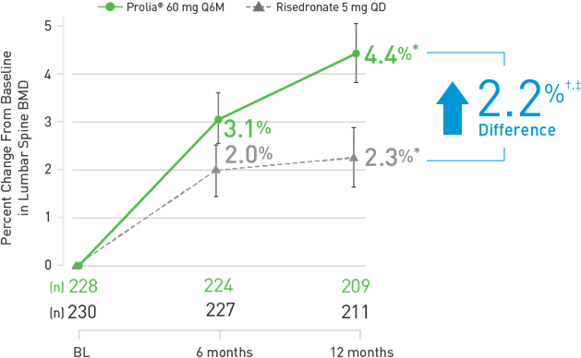
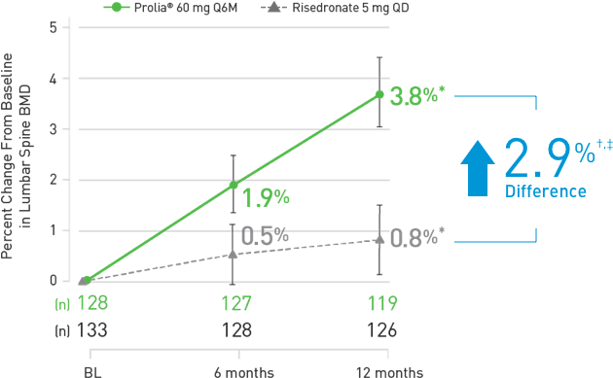
Denosumab has been evaluated in a head-to-head BMD study of patients with glucocorticoid-induced osteoporosis
Initiating Glucocorticoid Therapy
Continuing Therapy Glucocorticoid

Slide 55
Denosumab has been evaluated in a head-to-head BMD study of patients with glucocorticoid-induced osteoporosis
Denosumab delivered significantly greater improvements in lumbar spine BMD as early as 6 months
Percentage change from baseline in lumbar spine BMD with Denosumab vs risedronate in patients continuing glucocorticoids (3.1% vs 2.0%)

Slide 56
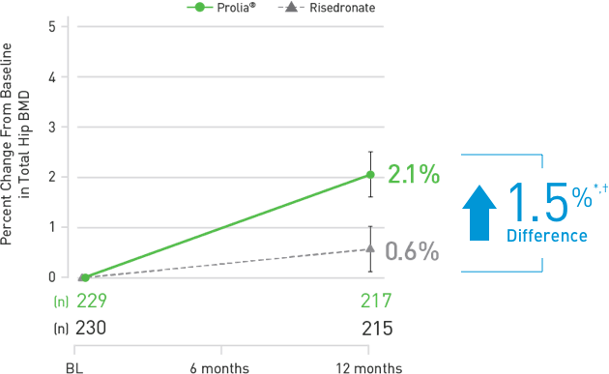
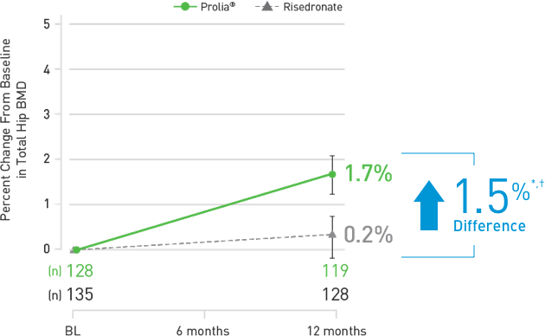
Denosumab has been evaluated in a head-to-head BMD study of patients with glucocorticoid-induced osteoporosis
Initiating Glucocorticoid Therapy
Denosumab demonstrated superiority in total hip BMD at 12 months vs risedronate
Continuing Glucocorticoid Therapy

Slide 57
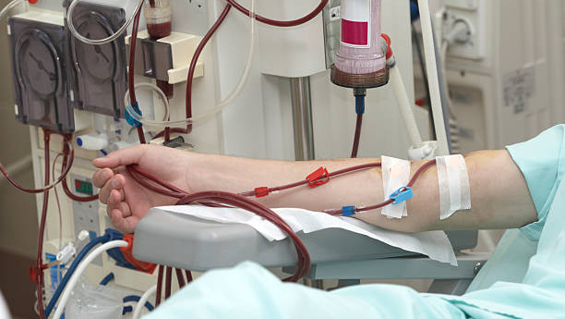
CKD/Hemodialysis Patients

Slide 58
Title: Effects of Denosumab on Fracture and Bone Mineral Density by Level of Kidney Function
Key massage: DMAb is safe and effective at reducing fracture risk and increasing BMD in osteoporosis patients with CKD stages 1 to 3
Aim: To examine the efficacy and safety of denosumab in participants who took part in the Fracture Reduction Evaluation of DMAb in Osteoporosis.
60 and 90 years of age with a BMD T-score of >-4.0 and <-2.5 at the lumbar spine or total hip
36 months
Denosumab at 60 mg subcutaneously every 6 months
Overall, compared with placebo, DMAb reduced the incidence of new vertebral fractures OR=0.30; 95% CI (0.23–0.39) as well as the incidence of nonvertebral fractures over 36 months OR=0.78, 95% CI 0.66– 0.93. DMAb was associated with an 8.8% (95% CI 8.6–9.1) increase in lumbar spine BMD, a 5.2% (95% CI 5.0–5.4) increase in femoral neck BMD, and a 6.4% (95% CI 6.3–6.5) increase in total hip BMD over 36 months.
N=3902 received denosumab
N=3906 received a placebo.
In conclusion, our post hoc analysis of subjects with stage 1 to 4 CKD suggests that DMAb is safe and likely effective at reducing fracture risk and increasing BMD in women with postmenopausal osteoporosis and stage 1 to 3 CKD
Abbreviations: BMD: Bone Mineral Density; CKD: Chronic kidney disease; DMAb: Denosumab; OR: odds ratio CI: confidence interval
Ref: Journal of Bone and Mineral Research, Vol. 26, No. 8, August 2011, pp 1829–1835.

Slide 59
Study Title | Effects of Denosumab and Alendronate on Bone Health and Vascular Function in Hemodialysis Patients
Reference | Journal of Bone and Mineral Research, Vol. 34, No. xx, Month 2019, pp 1–11
Study design / type | A Randomized, Controlled Trial
Objectives | To evaluate whether denosumab and alendronate are effective and safe treatments in hemodialysis patients
Study population | 48 HD patients who were diagnosed as having osteoporosis and had not received anti-osteoporotic agents previously.
Groups/Sample size | Randomized to either denosumab or intravenous alendronate, and all subjects received elemental calcium and calcitriol during the initial 2 weeks The primary endpoint was the percent change in lumbar spine bone mineral density (LSBMD) of treatment.
Duration of study | 12 months
Key findings | Denosumab and alendronate markedly decreased serum levels of BTM and increased LSBMD at 12 months compared with baseline. However, no significant differences were found in the changes in LSBMD between the two groups.
Conclusion | Denosumab and alendronate treatment improved LSBMD, reduced BTM, and appeared to be safe in hemodialysis patients with osteoporosis

Slide 60
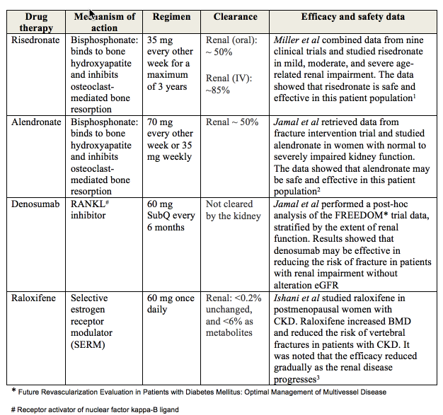
Osteoporosis treatment in patients with renal failure: the gray zone…

Slide 61
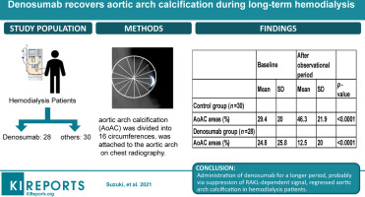
Notes:
Kidney Int Rep (2021) 6, 605–612;

Slide 62
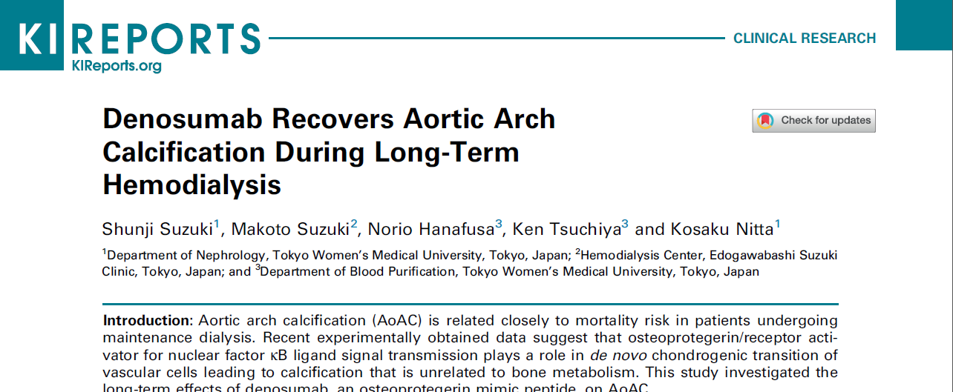
Conclusion: We conclude that long-term use of denosumab is effective to reverse or treat AoAC in patients undergoing hemodialysis.
Notes:
Kidney Int Rep (2021) 6, 605–612;

Slide 63
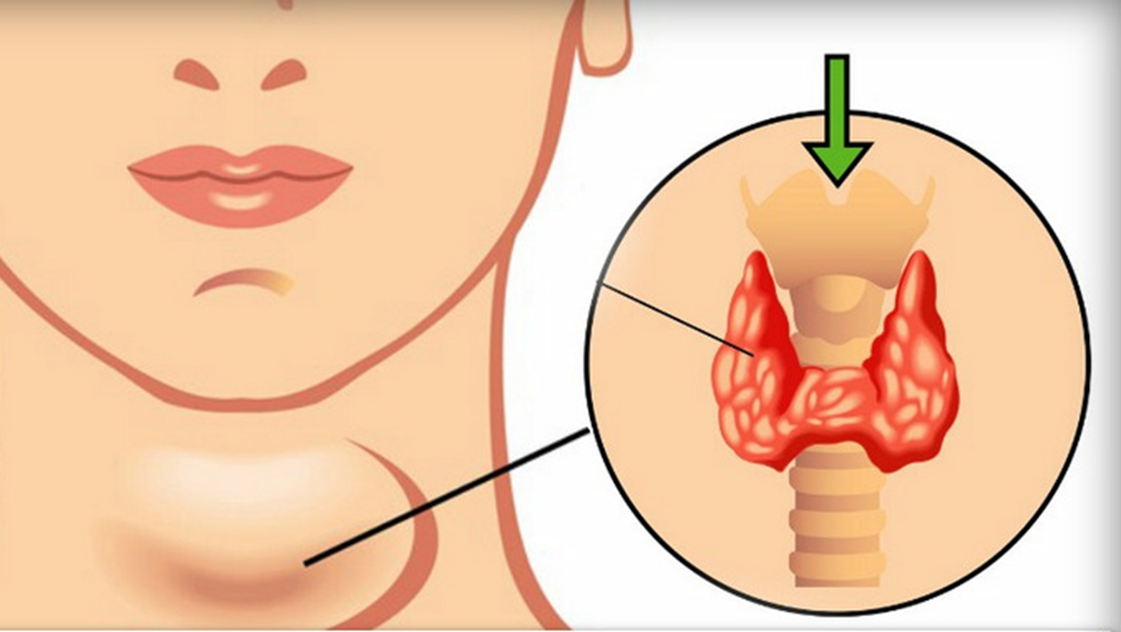
Primary Hyperparathyroidism

Slide 64
Study Title | Denosumab and cinacalcet for primary hyperparathyroidism (DENOCINA)
Reference | Lancet Diabetes Endocrinol 2020; 8: 407–17
Study design / type | A randomised, double-blind, placebo-controlled, phase 3 trial
Objectives | To assess the efficacy of denosumab and combined with cinacalcet in patients with primary hyperparathyroidism.
Study population | 46 patients were randomly assigned (1:1:1)
Groups / Sample size | N=16=denosumab group, N=15 combination group, N=15 placebo group
Duration of study | 52 weeks
Key findings | Compared with placebo, BMD improved in groups receiving denosumab: lumbar spine (combination group 5·4%, denosumab group 6·9%; p<0·0001),total hip (combination group 5·0%, denosumab group 4·1% ; p<0·0001), and femoral neck (combination group 4·5%, denosumab group 3·8% ; p=0·0022]). Changes in BMD at the third distal forearm were borderline significant. Six non-fatal serious adverse events occurred (combination group [n=2], denosumab group [n=1], placebo group [n=3]).
Conclusion | Evidence suggested denosumab was effective in improving BMD and lowering bone turnover inpatients with primary hyperparathyroidism irrespective of cinacalcet treatment and might be a valid option for patients in which surgery is undesirable.

Slide 65
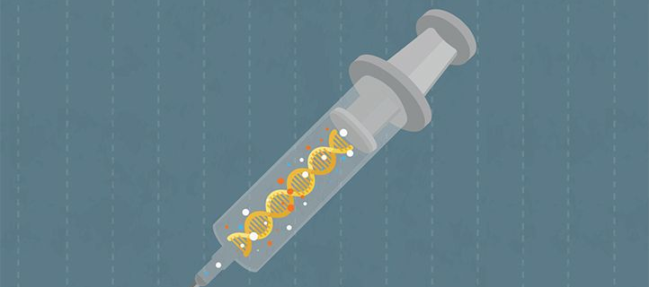
Safety of Denosumab

Slide 66
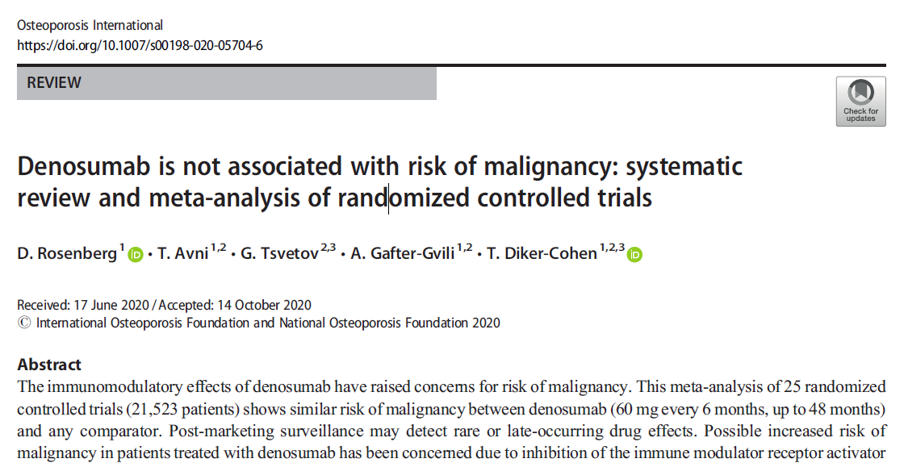
Early concerns about a potential increased risk of malignancy resulting froman immunomodulatory effect of denosumab are not supported by evidence from this meta-analysis of 25 RCTs with drug exposure of up to 48 months

Slide 67
Study Title | Denosumab is not associated with risk of malignancy
Reference | Osteoporos Int . 2021 Oct;32(10):2131.
Study design / type | Systematic review and meta-analysis of randomized controlled trials
Objectives | To assess the risk of malignancy associated with denosumab treatment
Study population | 25 RCT (21,523 patients)
Groups / Sample size | PubMed and Cochrane Central Register of Controlled Trials were searched up to May 27, 2019 to include all RCTs of denosumab (60 mg every 6 months) versus any comparator.
Key findings | The risk of malignancy did not differ between groups in any of the subgroup analyses, including stratification by race, individual comparators, indications for treatment, and longer drug exposure (≥ 24 months, 9 studies). The risk ratio of malignancy-related death was similar between groups. Early concerns about a potential increased risk of malignancy resulting from an immunomodulatory effect of denosumab are not supported by evidence from this meta-analysis of 25 RCTs with drug exposure of up to 48 months
Conclusion | In summary, evidence from this meta-analysis of 25 RCTs with denosumab exposure of up to 48 months does not support early concerns about a potential increased risk of malignancy resulting from an immunomodulatory effect of the drug.

Slide 68
Study Title | Safety of denosumab in postmenopausal women with osteoporosis or low bone mineral density
Reference | Int J Clin Exp Pathol 2014;7(5):2113-2122.
Study design / type | A meta-analysis
Objectives | To assess the safety of denosumab in postmenopausal women with osteoporosis or low BMD
Study population | A total of 11 English literatures were eventually identified.
Groups / Sample size | Safety of denosumab was compared with placebo or bisphosphonates. A systematic literature search without language restriction was conducted up to January 2014. The Rev Man 5.1 software was used for statistical analysis.
Key findings | There was no significant difference when compared denosumab with placebo or bisphosphonates in any adverse events (AAE), SAE, neoplasm/cancer. The results of subgroup analysis did not demonstrate the differences between denosumab and bisphosphonates in SAE related to infection
Conclusion | There was no difference between the safety of denosumab and bisphosphonates

Slide 69
Study Title | Denosumab or romosozumab therapy and risk of cardiovascular events in patients with primary osteoporosis
Reference | Bone. 2020 Jan;130:115121.
Study design / type | Systematic review and meta- analysis
Objectives | To investigate the effect of denosumab or romosozumab therapy on cardiovascular outcomes in patients with primary osteoporosis.
Study population | 17 relevant studies
Groups / Sample size | Denosumab: n=11, 13615 participants; romosozumab: n=6, 12219 participants
Duration of study
Key findings | No associations between denosumab therapy and risk of a composite cardiovascular outcome, three-point major adverse cardiovascular event (3P MACE), and four-point major adverse cardiovascular event (4P MACE) were identified Denosumab or romosozumab did not increase or reduce specific cardiovascular outcomes, including CV death or death, myocardial infarction, stroke, atrial fibrillation, heart failure, aortic and intracranial aneurysm, aortic dissection, aortic valve disease and hypertension (all p＞0.05).
Conclusion | Denosumab therapy was not associated with any risk of composite and specific cardiovascular outcomes among patients with primary osteoporosis than active comparators or placebo

Slide 70
Summary and recommendations
Calcium and vitamin D supplementation
eGFR ≥30 mL/min/1.73 m
eGFR <30 mL/min/1.73
Treatment of hypogonadism
Patients with an eGFR ≥30 mL/min/1.73 m should have calcium and vitamin D supplementation similar to patients with normal GFR, as long as there is no biochemical evidence for CKD-MBD (chronic kidney disease-mineral bone disorder; eg, hyperparathyroidism, hyperphosphatemia)
For patients with an eGFR <30 mL/min/1.73 m, we suggest calcium and vitamin D supplementation (Grade 2C).
The target calcium intake (total diet plus supplement) is 1200 mg/day, with 500 mg/day or less of this total amount provided by calcium supplementation.
The difference between the calcium provided by supplementation and total calcium intake should be provided by nutritional means.
In addition, patients should take 800IU of vitamin D daily.
For hypogonadal, premenopausal women with CKD and low bone mass and/or fragility fracture, we suggest oral contraceptive (if not contraindicated) or estradiol/progestin replacement therapy as initial therapy, rather than pharmacologic therapy (Grade 2B).
For men with CKD, osteoporosis, and symptomatic hypogonadism, we recommend testosterone therapy (if not contraindicated) (Grade 1B).
Premenopausal women and men with CKD who are taking hormone replacement therapy may not require additional pharmacologic therapy for osteoporosis
Notes:
https://www.uptodate.com/contents/osteoporosis-in-patients-with-chronic-kidney-disease-management/print

Slide 71
Summary and recommendations
Osteoporosis pharmacologic therapy
eGFR ≥30 mL/min/1.73 m and no evidence of CKD-MBD
eGFR <30 mL/min/1.73 m or with evidence of CKD-MBD, without fragility fracture
eGFR <30 mL/min/1.73 m or with evidence of CKD-MBD, with fragility fracture
For patients with aneGFR ≥30 mL/min/1.73 m and no evidence of CKD-MBD, the selection of patientsfor pharmacologic therapy should be the same as for patients without CKD
For patients with eGFR <30 mL/min/1.73 m (or eGFR ≥30 mL/min/1.73m with evidence of CKD-MBD) and low BMD without fragility fracture, we suggest not treating with pharmacologic therapy
Patients with an eGFR <30 mL/min/1.73 m with a fragility fracture may be candidates for pharmacologic therapy
Notes:
https://www.uptodate.com/contents/osteoporosis-in-patients-with-chronic-kidney-disease-management/print

Slide 72
Summary and recommendations
eGFR 15 to 30 mL/min/1.73 m
eGFR <15 mL/min/1.73 m
Bisphosphonate precautions
For fracturing patients with eGFR of 15 to 30mL/min/1.73 m who are candidates for pharmacologic therapy, we suggest an oral bisphosphonate (Grade 2B).
Denosumab, which is not cleared by the kidney, is an alternative option.
For fracturing patients with eGFR <15 mL/min/1.73m who are candidates for pharmacologic therapy, we suggest an oral bisphosphonate (Grade 2C).
We typically prescribe risedronate 35 mg every other week (ie, one-half the usual dose) and for not more than three years.
Denosumab is an alternative, although denosumab administration in hemodialysis patients has been associated with clinically significant hypocalcemia.
Bisphosphonates should not be used routinely in patients with an eGFR <30 mL/min/1.73 m (<35 mL/min/1.73 m for zoledronicacid) and should only be considered in such patients by clinicians with expertise in MBD and after excluding renal osteodystrophy.
Notes:
https://www.uptodate.com/contents/osteoporosis-in-patients-with-chronic-kidney-disease-management/print

Slide 73
Thank you…!!!!

